Slide 1
First-Order Logic

Slide 2
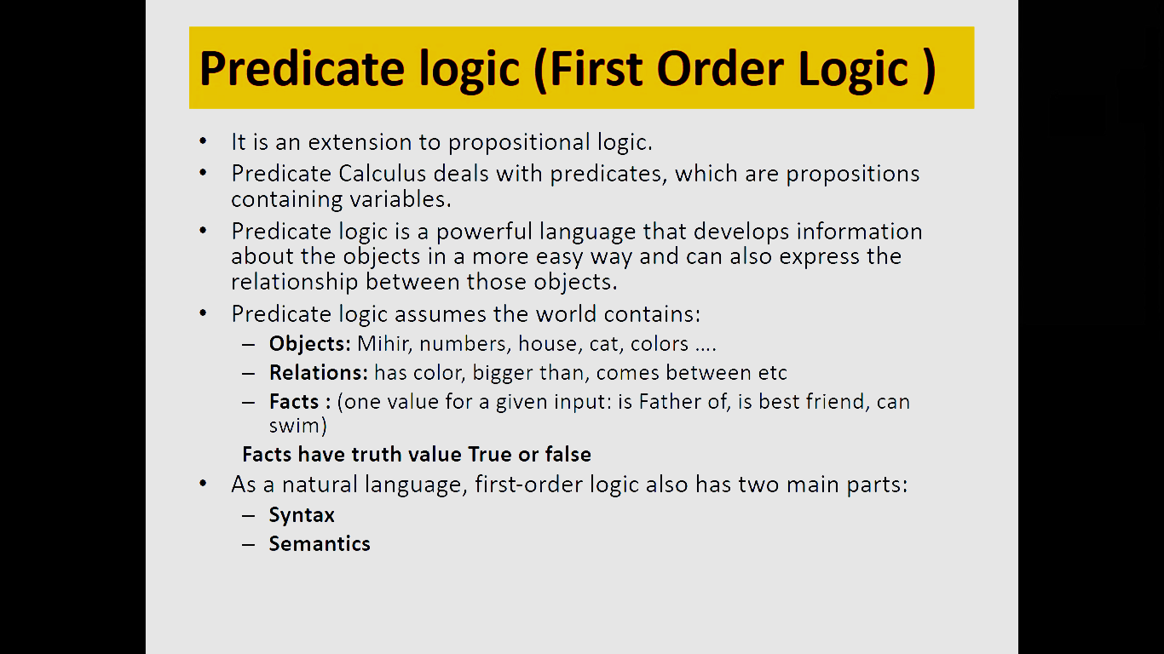

Slide 3
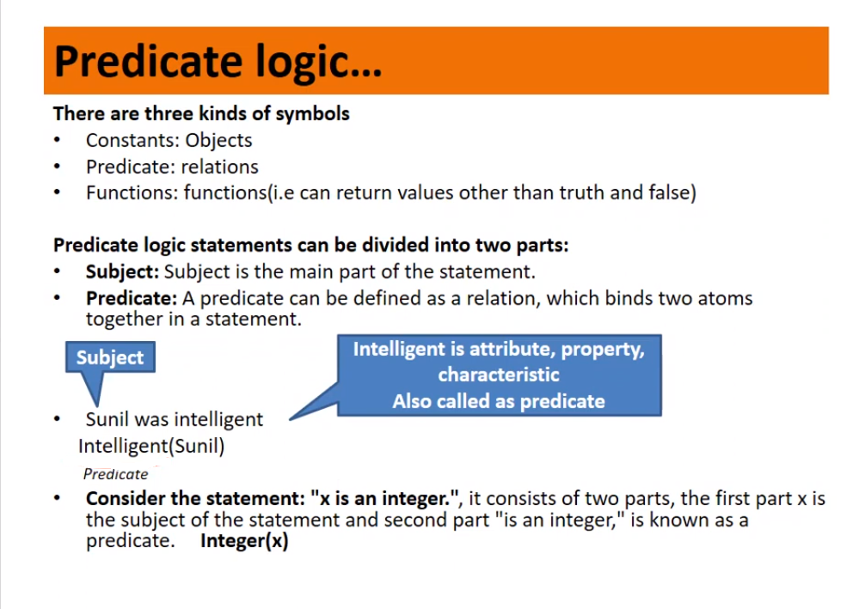

Slide 4
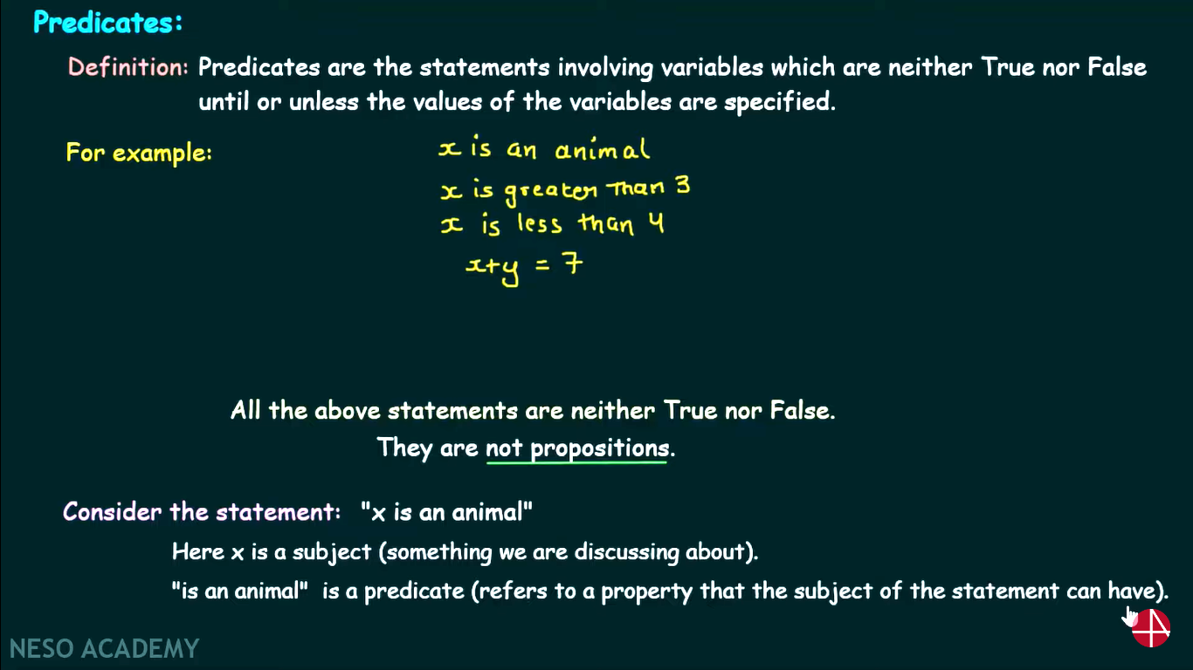

Slide 5
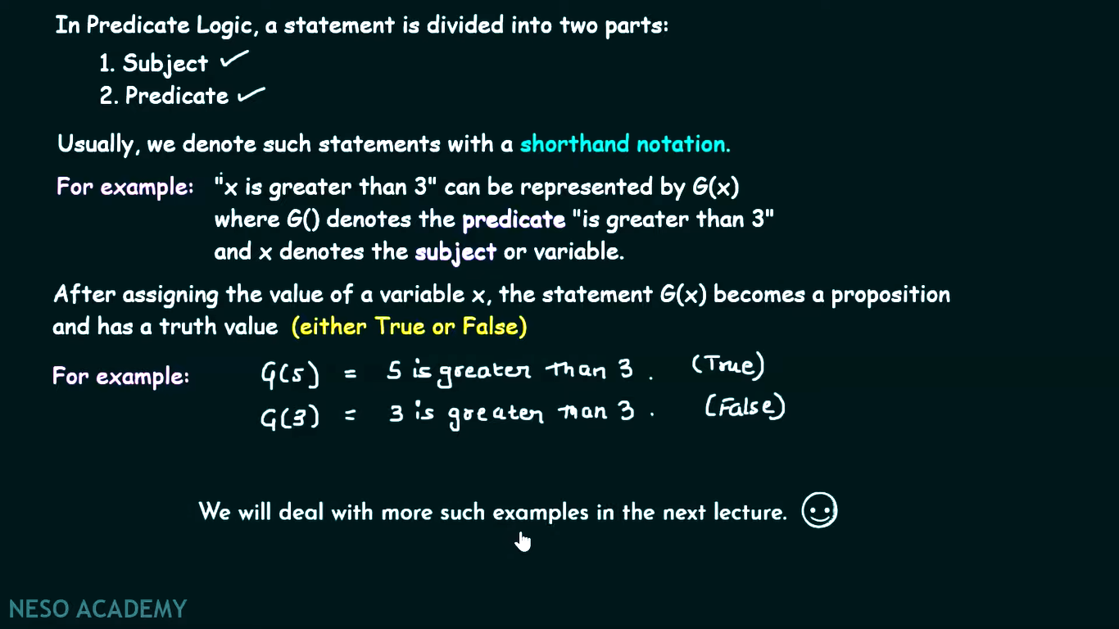

Slide 6
User provides
Constant symbols, which represent individuals in the world
Mary
3
Green
Function symbols, which map individuals to individuals
father-of(Mary) = John
color-of(Sky) = Blue
Predicate symbols, which map individuals to truth values
greater(5,3)
green(Grass)
color(Grass, Green)

Slide 7
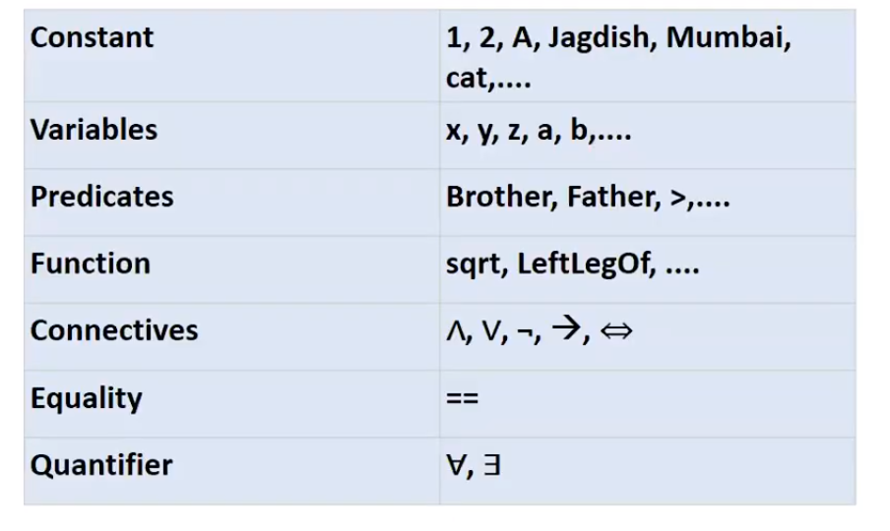
Basic Elements

Slide 8
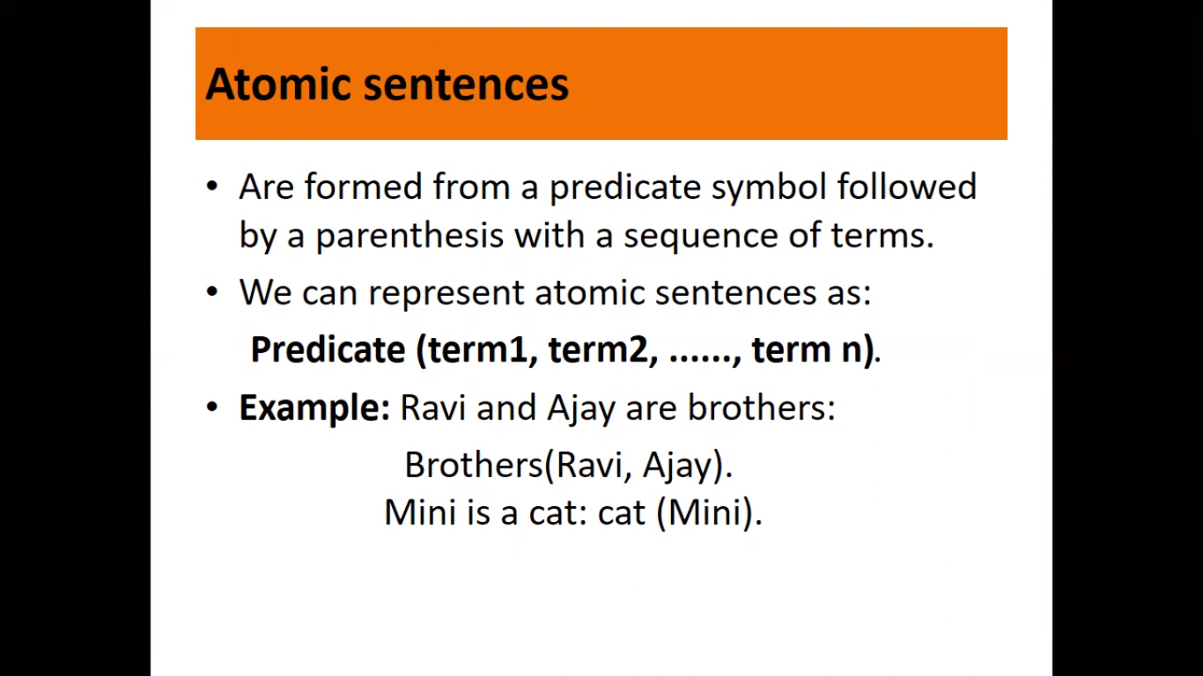

Slide 9
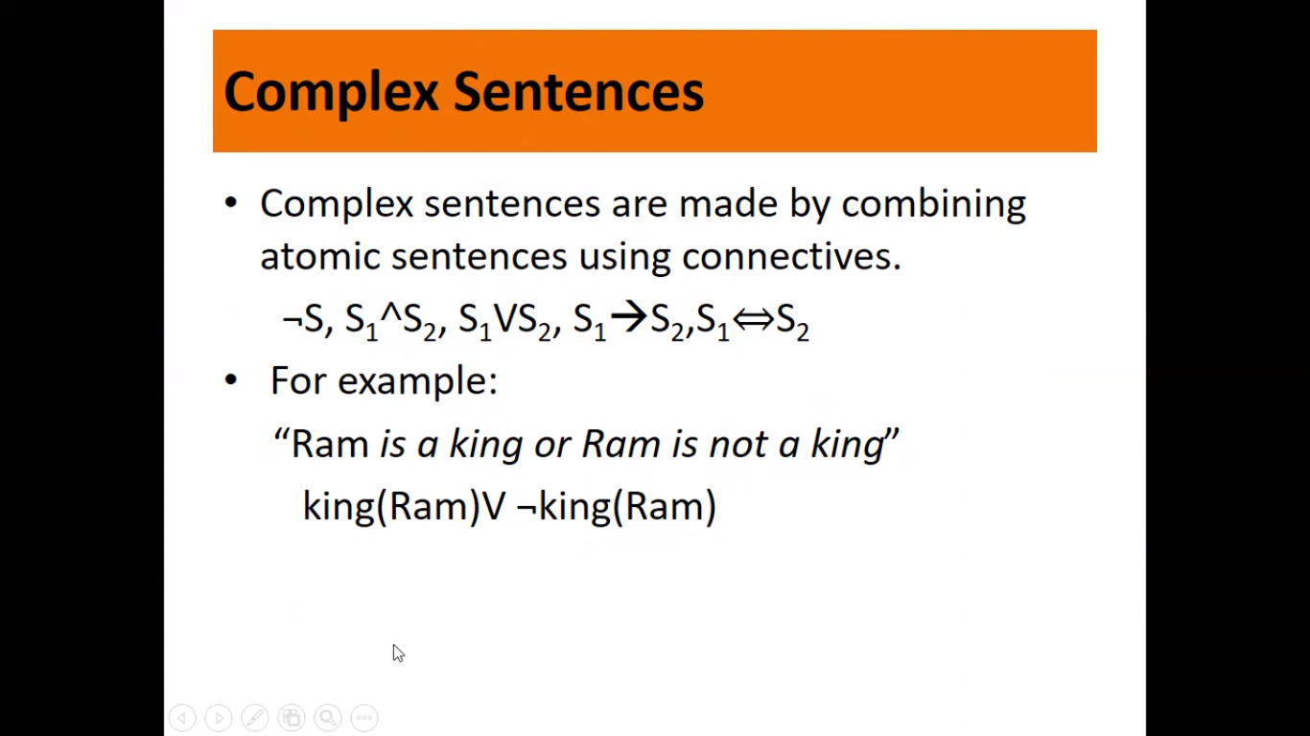

Slide 10
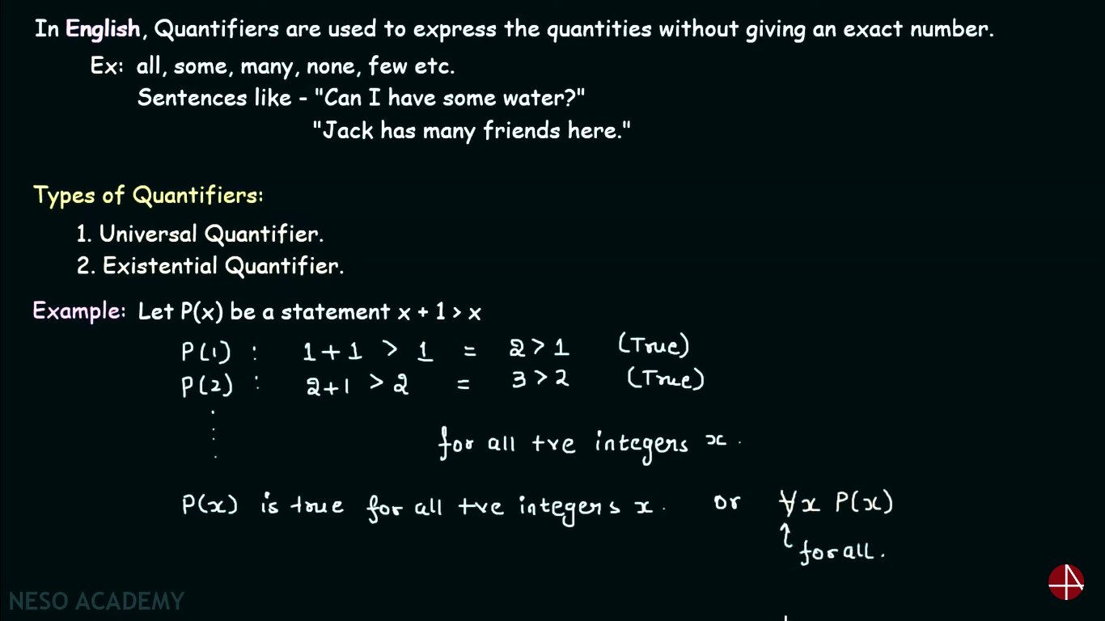

Slide 11
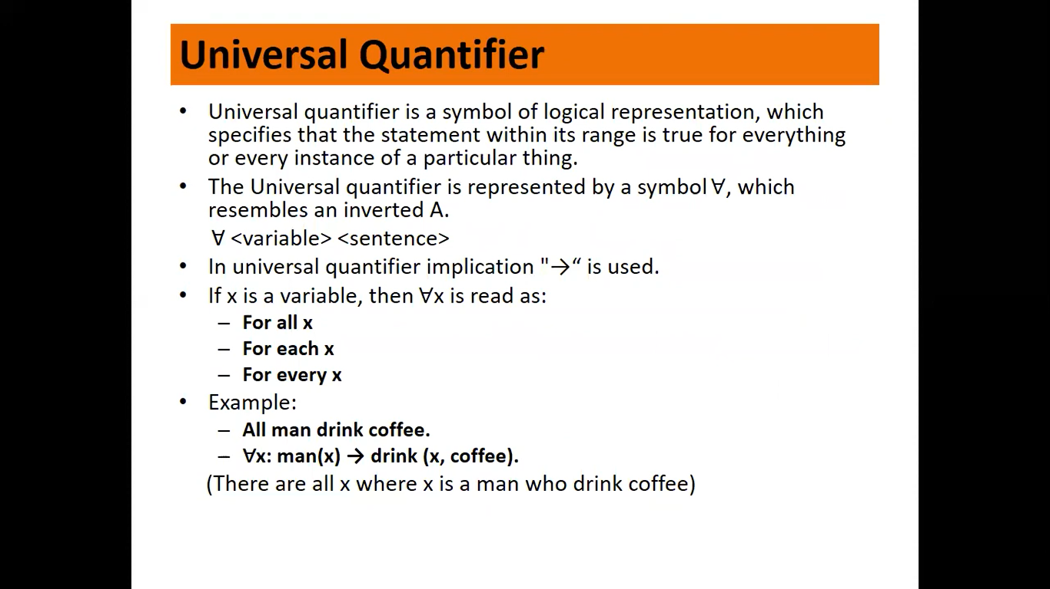

Slide 12
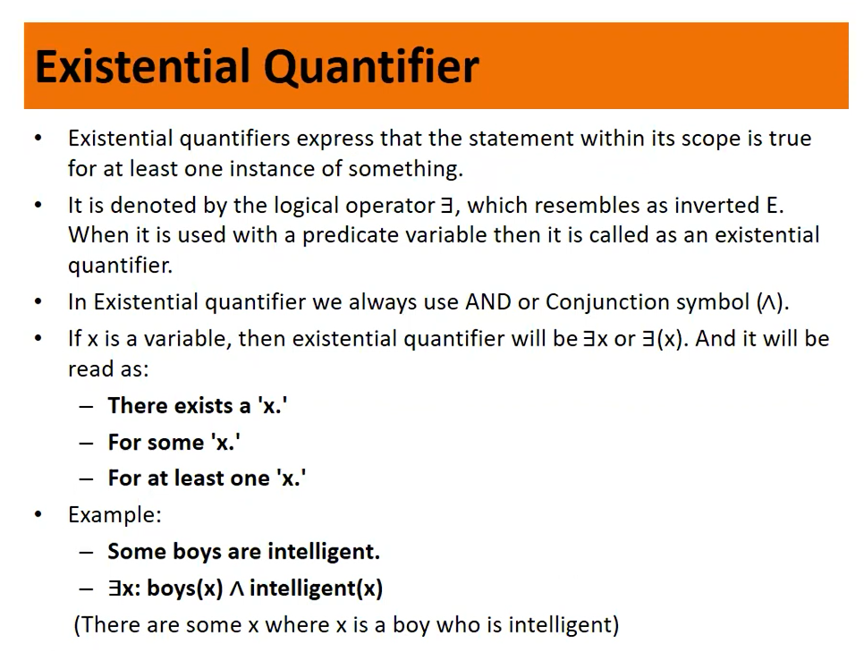

Slide 13
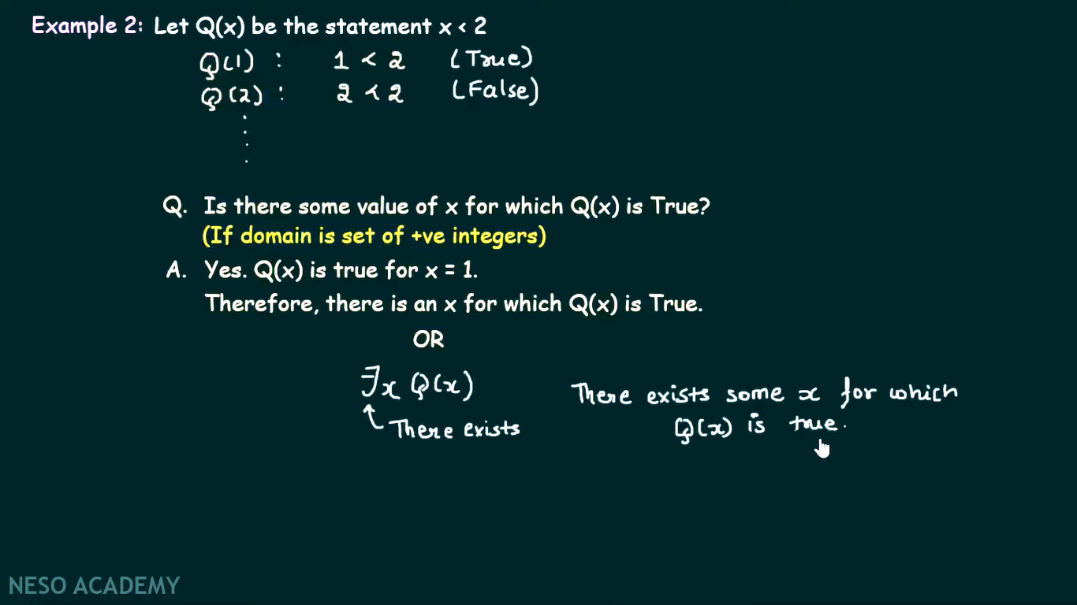

Slide 14
Quantifiers
Universal quantification
(∀x)P(x) means that P holds for all values of x in the domain associated with that variable
E.g., (∀x) dolphin(x) → mammal(x)
Existential quantification
(∃ x)P(x) means that P holds for some value of x in the domain associated with that variable
E.g., (∃ x) mammal(x) ∧ lays-eggs(x)
Permits one to make a statement about some object without naming it

Slide 15
Quantifiers
Universal quantifiers are often used with “implies” to form “rules”:
(∀x) student(x) → smart(x) means “All students are smart”
Universal quantification is rarely used to make blanket statements about every individual in the world:
(∀x)student(x)∧smart(x) means “Everyone in the world is a student and is smart”
Existential quantifiers are usually used with “and” to specify a list of properties about an individual:
(∃x) student(x) ∧ smart(x) means “There is a student who is smart”
A common mistake is to represent this English sentence as the FOL sentence:
(∃x) student(x) → smart(x)

Slide 16
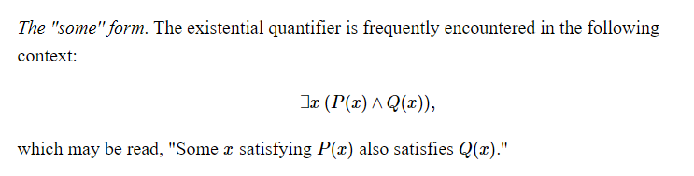
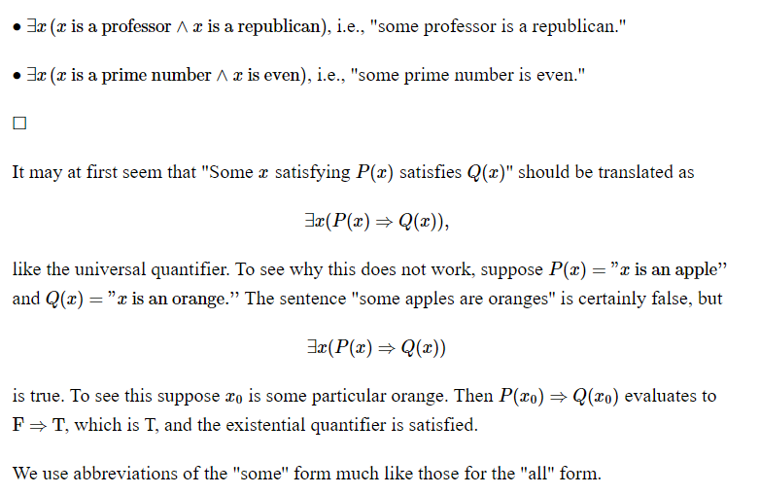

Slide 17
Quantifier Scope
Switching the order of universal quantifiers does not change the meaning:
(∀x)(∀y)P(x,y) ↔ (∀y)(∀x) P(x,y)
Similarly, you can switch the order of existential quantifiers:
(∃x)(∃y)P(x,y) ↔ (∃y)(∃x) P(x,y)
Switching the order of universals and existentials does change meaning:
Everyone likes someone: (∀x)(∃y) likes(x,y)
Someone is liked by everyone: (∃y)(∀x) likes(x,y)

Slide 18
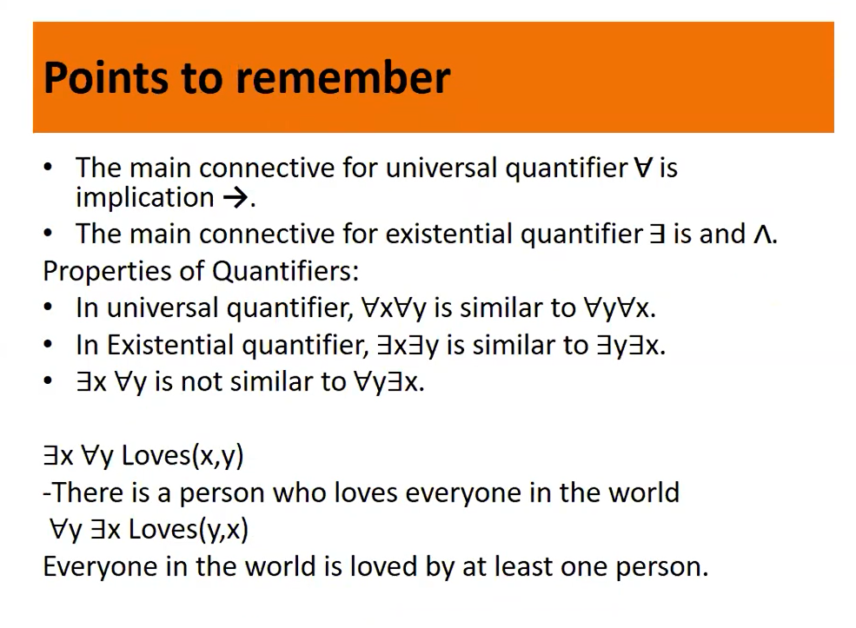

Slide 19
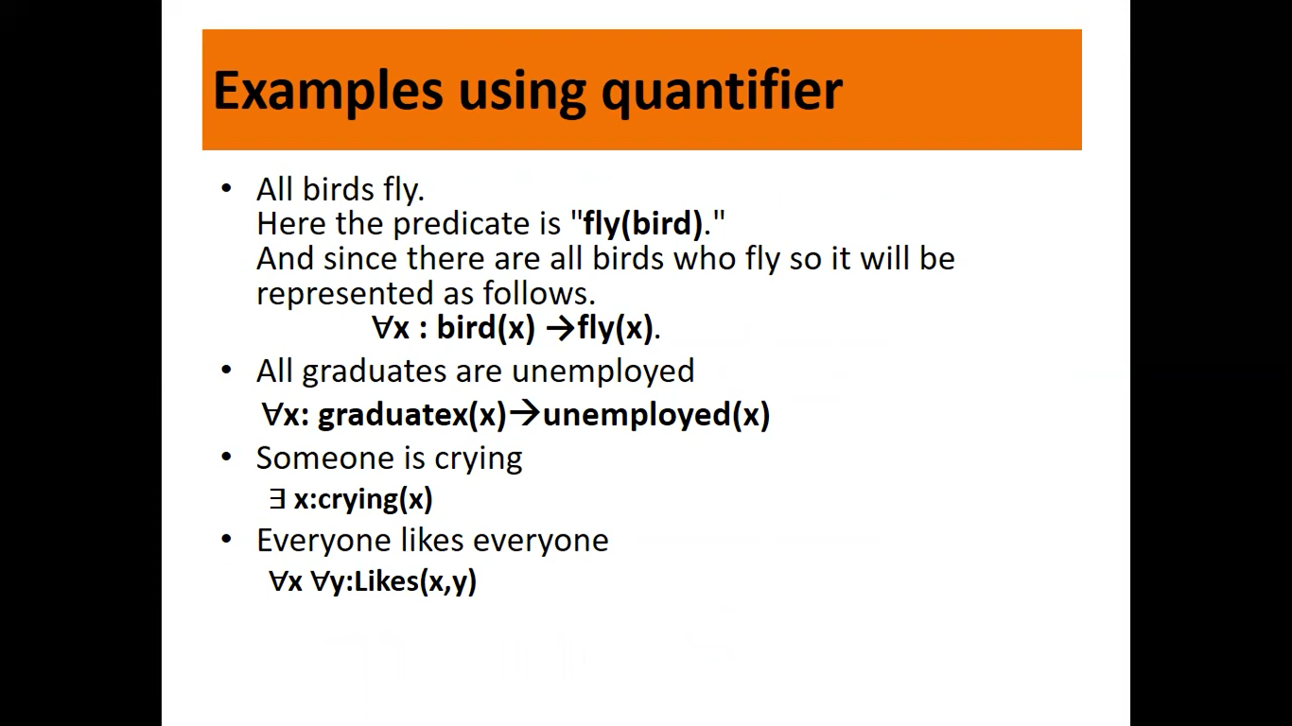

Slide 20
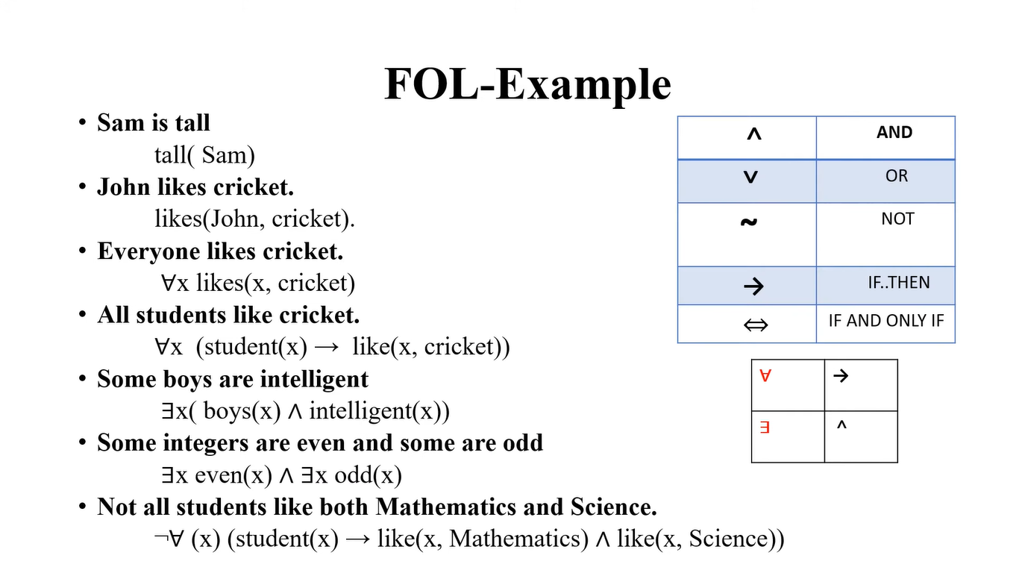
w

Slide 21
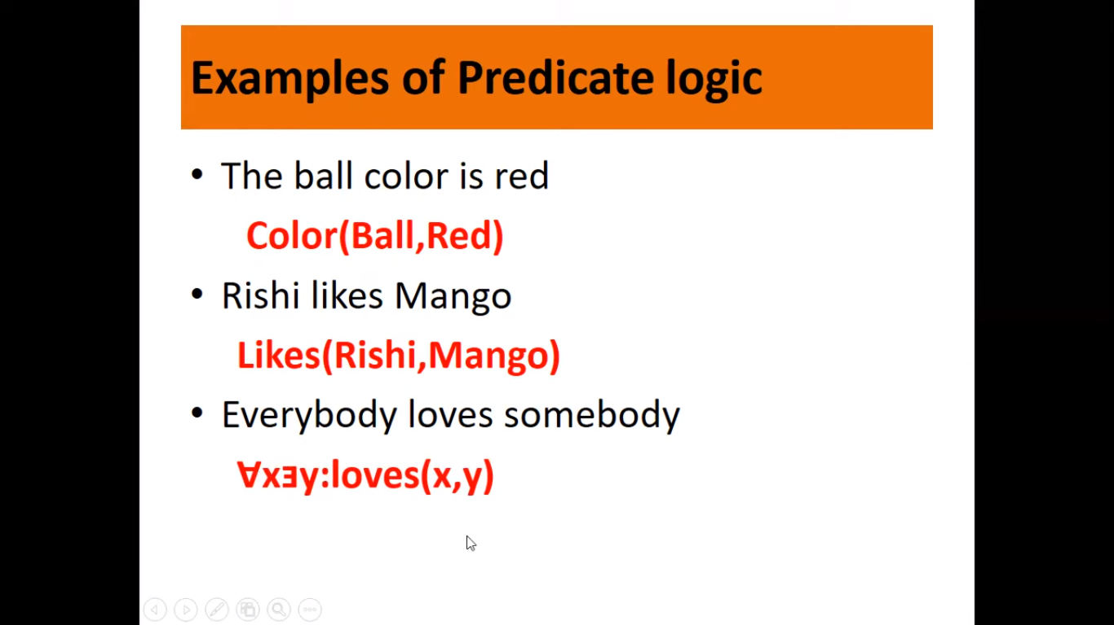
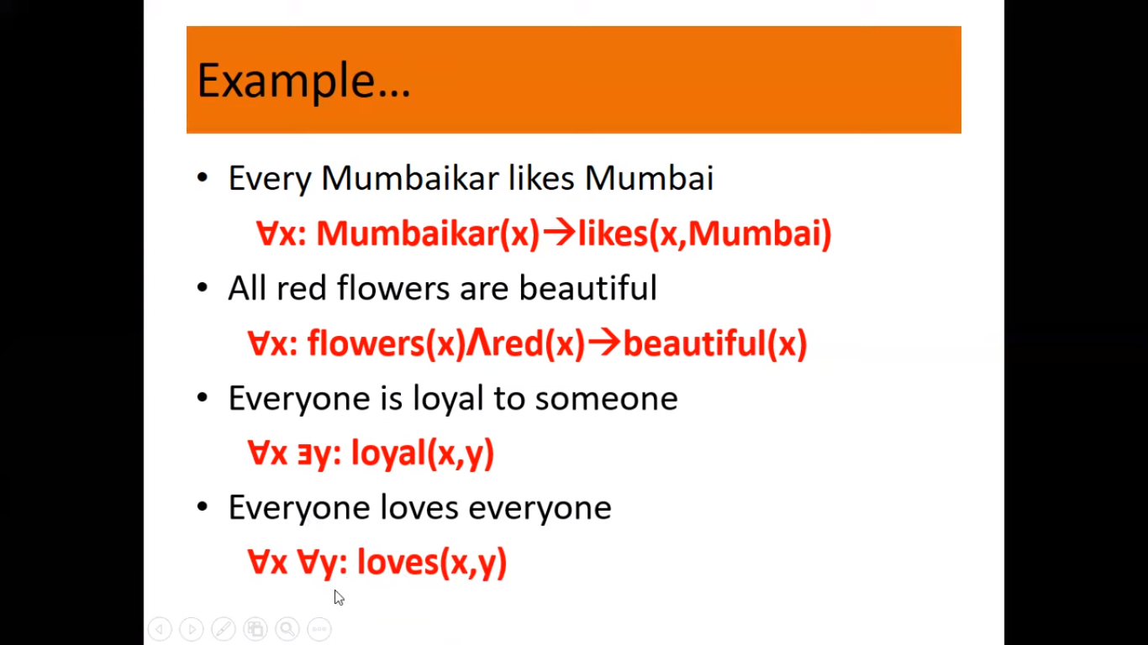
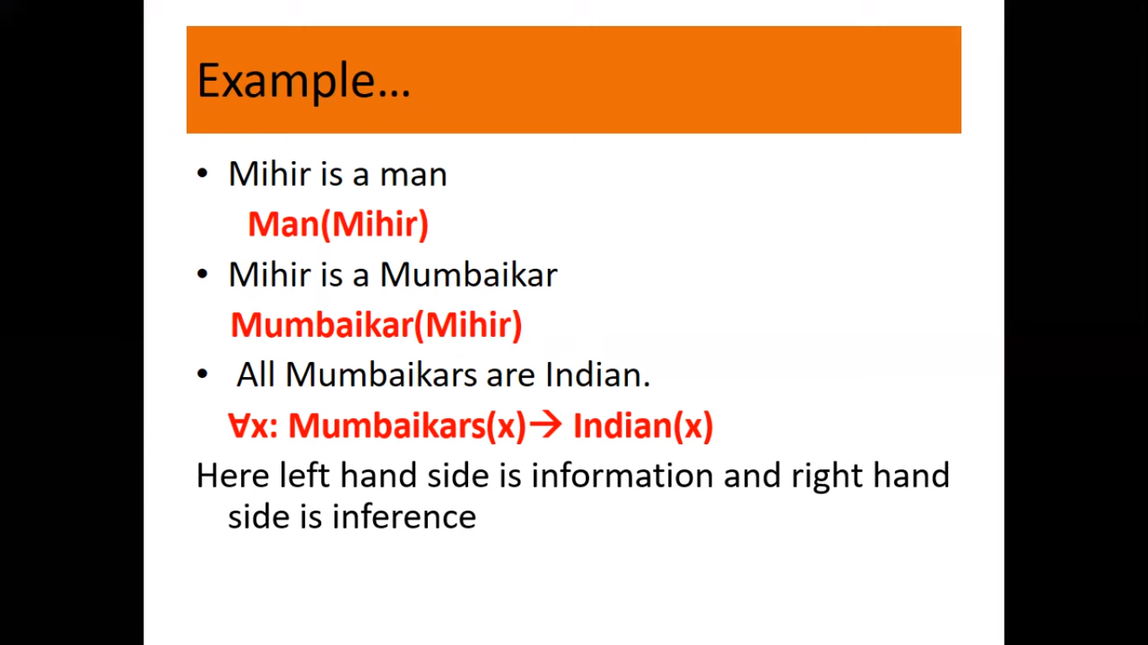

Slide 22
Translating English to FOL
Every gardener likes the sun.
∀x gardener(x) → likes(x,Sun)
There exists a smart student.
∃x (Student(x) ∧ Smart (x))
Bill has at least one sister.
∃x SisterOf(x,Bill)
All purple mushrooms are poisonous.
∀x (mushroom(x) ∧ purple(x)) → poisonous(x)
Clinton is not tall.
¬tall(Clinton)
Bill does not take Analysis.
¬Takes(Bill,Analysis)
You can fool some of the people all of the time.
∃x ∀t person(x) ∧time(t) → can-fool(x,t)
You can fool all of the people some of the time.
∀x ∃t (person(x) → time(t) ∧can-fool(x,t))
∀x (person(x) → ∃t (time(t) ∧can-fool(x,t))
No purple mushroom is poisonous.
¬∃x purple(x) ∧ mushroom(x) ∧ poisonous(x)
∀x (mushroom(x) ∧¬ purple(x)) → ¬poisonous(x)
Equivalent
Equivalent

Slide 23
Connections between All and Exists
We can relate sentences involving ∀ and ∃ using De Morgan’s laws:
(∀x) ¬P(x) ↔ ¬(∃x) P(x)
¬(∀x) P(x) ↔ (∃x) ¬P(x)
(∀x) P(x) ↔ ¬ (∃x) ¬P(x)
(∃x) P(x) ↔ ¬(∀x) ¬P(x)

Slide 24
Inference in First Order Logic
In artificial intelligence, we need intelligent computers which can create new logic from old logic or by evidence, so generating the conclusions from evidence and facts is termed as Inference.
Inference in First-Order Logic is used to deduce new facts or sentences from existing sentences.
Inference rules are the templates for generating valid arguments. Inference rules are applied to derive proofs in artificial intelligence, and the proof is a sequence of the conclusion that leads to the desired goal.

Slide 25
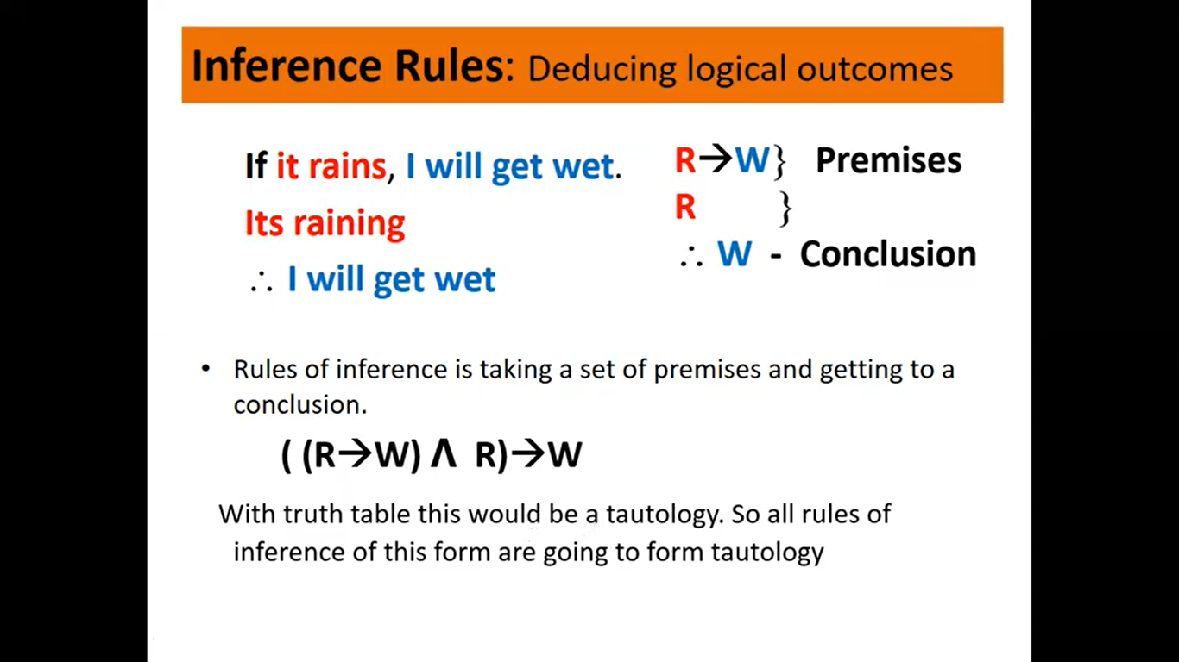

Slide 26
Quantified inference rules
Universal instantiation
∀x P(x) ∴ P(A)
Universal generalization
P(A) ∴ ∀x P(x)
Existential instantiation
∃x P(x) ∴P(F) ← skolem constant F
Existential generalization
P(A) ∴ ∃x P(x)

Slide 27
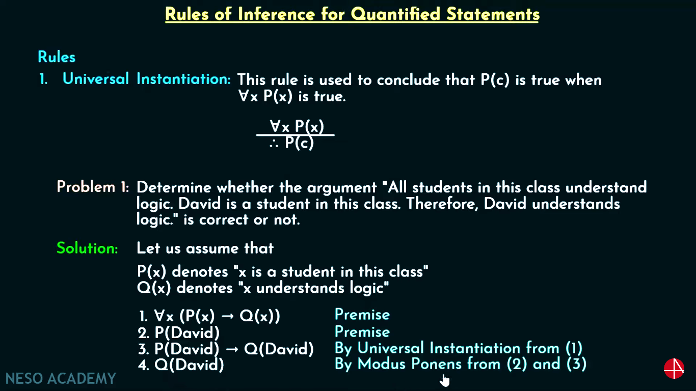
Universal instantiation (a.k.a. universal elimination)
If (∀x) P(x) is true, then P(C) is true, where C is any constant in the domain of x
Example:
(∀x) eats(Ziggy, x) ⇒ eats(Ziggy, IceCream)
The variable symbol can be replaced by any ground term, i.e., any constant symbol or function symbol applied to ground terms only

Slide 28
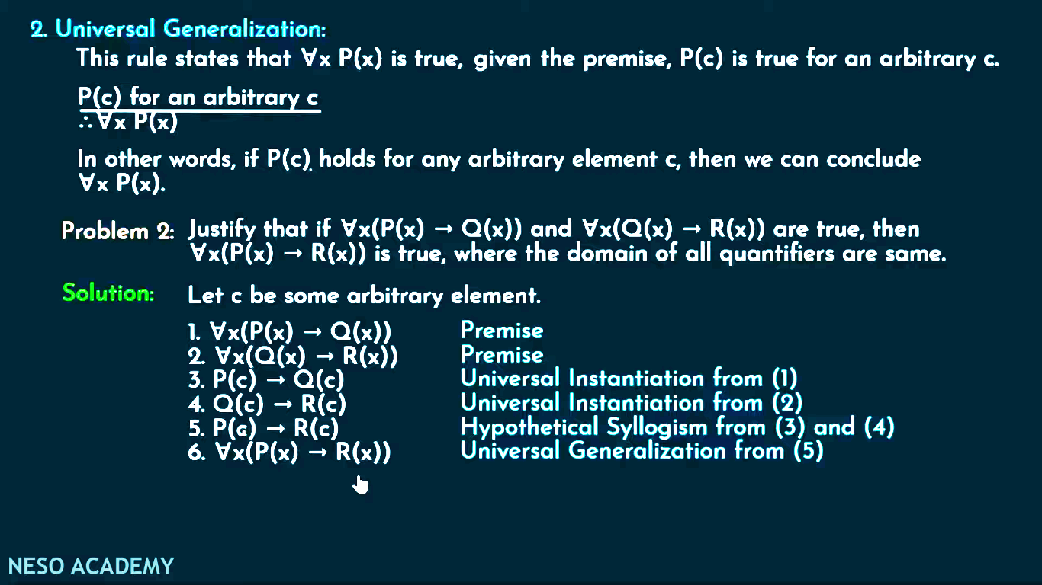
Let's represent, P(c): "A byte contains 8 bits", so for ∀ x P(x) "All bytes contain 8 bits.", it will also be true.

Slide 29
Existential instantiation (a.k.a. existential elimination)
From (∃x) P(x) infer P(c) for some c
Example:
(∃x) eats(Ziggy, x) → eats(Ziggy, Stuff)
Note that the variable is replaced by a brand-new constant not occurring in this or any other sentence in the KB
Also known as skolemization; constant is a skolem constant
In other words, we don’t want to accidentally draw other inferences about it by introducing the constant
Convenient to use this to reason about the unknown object, rather than constantly manipulating the existential quantifier

Slide 30
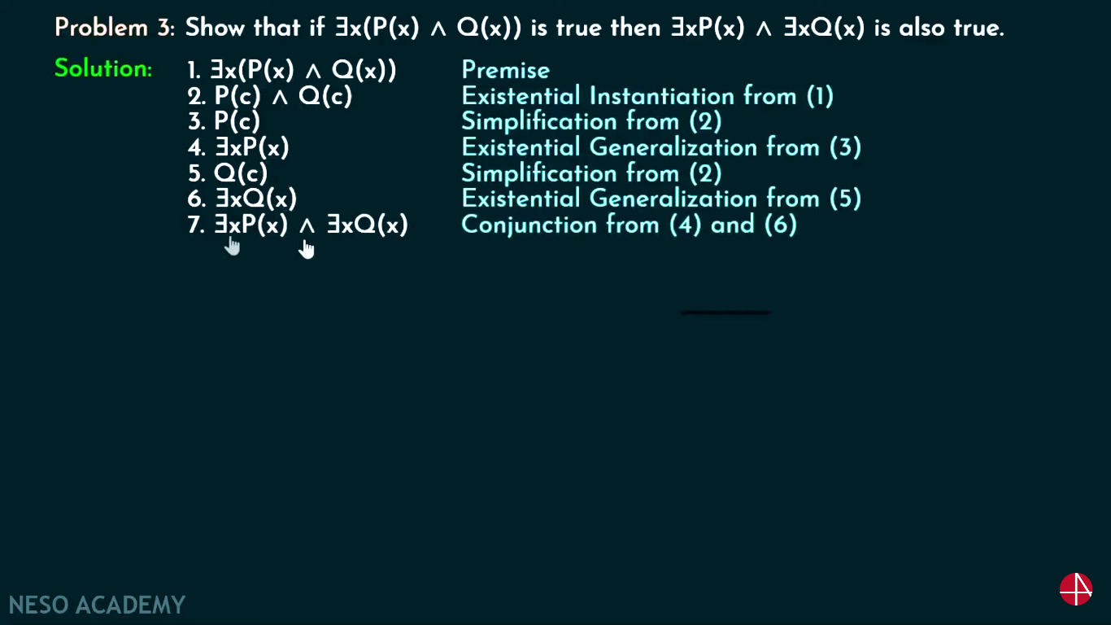
Existential generalization (a.k.a. existential introduction)
If P(c) is true, then (∃x) P(x) is inferred.
Example
eats(Ziggy, IceCream) ⇒ (∃x) eats(Ziggy, x)
All instances of the given constant symbol are replaced by the new variable symbol
Note that the variable symbol cannot already exist anywhere in the expression

